Slide 1
Ready to go further?
JUNE 2025

Slide 2

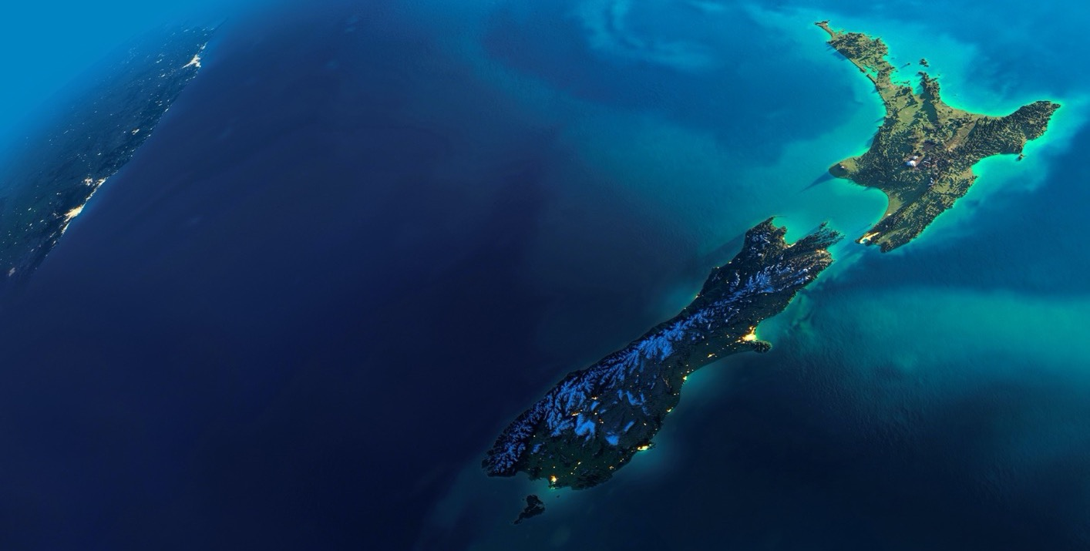
Our purpose
To grow companies
internationally
– bigger, better, faster –
for the good
of New Zealand.
Notes:
Speaker notes:
International trade is critical to New Zealand. The success of our country’s economy is directly related to the success of our exporters. In FY24 international trade delivered $95 billion of revenue and employed one in four people. New Zealand Trade and Enterprise is the government agency charged with helping New Zealand businesses to grow internationally for the good of New Zealand. We do this by working with exporters to help them scale on the world stage and by matching investors with investment opportunities.
We use our extensive knowledge and global networks to help exporters of all sizes make better decisions and connect to the right partners and investors. NZTE provides customised services, expertise and connections to ambitious New Zealand businesses looking to go global. We also connect international investors with opportunities in New Zealand, through a worldwide network of investment advisors.
Our strategy: supporting NZInc to double the value of exports in 10 years.

Slide 3



International trade is critical to New Zealand's success
$100b
1 in
4 jobs
Notes:
Speaker notes
New Zealand is – and always has been - a trading nation.
International trade is critical to New Zealand, and we need exports and investment in order to grow and prosper.
The success of our country’s economy is directly related to the success of our exporters.
Trade exports are critical to New Zealand’s economy and support our regions and communities. They fuel job creation, production, and revenue, and help us build relationships with other countries.
To end-of-December 2024, New Zealand exports surpassed $100* billion of revenue for the very first time, and employed one in four people with those in exporting jobs earning 7% more on average than in other sectors.
Businesses that export have 25% higher productivity and grow faster than non-exporting ones.

Slide 4






NZTE Key Facts
$3.81b
EXPORT DEALS
5,650
EXPORT
CUSTOMERS
620
PEOPLE
WORLDWIDE
420
PRIVATE SECTOR ADVISORS (BEACHEADS)
47
WORLDWIDE OFFICES
(10 IN NEW ZEALAND)
All figures as at 30 June 2024.
Notes:
Speaker notes
Refer to the slide.
Around 44% of our people are based offshore.
Beachheads is a network of over 350 private sector experts based across our global markets and New Zealand, who offer perspective and insights around a specific need, challenge, or opportunity to help shape international business expansion.

Slide 5


How we work
FOCUS CUSTOMERS
ENGAGED CUSTOMERS
Notes:
Speaker notes
We work with New Zealand businesses and Māori entities of all sizes to help them prepare to export, prepare to raise capital, enter new markets and accelerate their international growth.
To achieve the most impact from our limited resources NZTE therefore targets its support at two key export customer segments:
Export customers
When you have big business ambitions in a small country, exporting can be a natural next step.
Growing your business overseas can be tough, and getting the right support at the right time can make all the difference.
NZTE is here to help. We draw on our global network of expertise and contacts to help exporters make better decisions and connections, wherever they are in the world.
NZTE uses our extensive knowledge and global networks to help exporters of all sizes make better decisions and connect to the right partners and investors.
There are over 5,600 export customers that NZTE has a relationship with, of which 1000 of them, we have an intensive relationship with, and we call these Focus customers.
Export customers - Focus
Focus customers primarily interact with us through a dedicated Customer Manager in New Zealand and assigned BDMs in international locations.
They receive tailored and personalised support to grow internationally and are generally more established exporters already generating international revenue.
Export customers - Engaged
The rest are known as Engaged customers, New Zealand exporters that work with us on a less intensive basis and use our support and services at their own pace depending on the needs of their business at a particular time.
Engaged customers primarily interact with us through our team of Customer Advisors and through myNZTE, our online portal.
Most, but not all, Engaged customers are at an earlier stage in their international journey or exporting may not be a current priority.

Slide 6

Exporters – who we work with
Number of New Zealand
exporters by revenue band
319
COMPANIES
earn > $25 million
631
COMPANIES
earn $5–$25 million
1029
Focus
Customers
9,256
COMPANIES
4621
Engaged Customers
earn <$5 million
NUMBER OF NEW ZEALAND EXPORTERS
*Source: Statistics New Zealand (generalised); based on goods and services companies, excluding travel, transportation services, and insurance services, which cannot be identified at a company level.
Number of NZTE customers to 30 June 2024
Notes:
Speaker notes
While New Zealand is a good place to start a business (compared to most other countries) it is also a relatively challenging place from which to grow a business.
A small domestic economy means that New Zealand exporters need to go-global at a very early stage, and distance from international markets pose creates disadvantages in supply chain, market knowledge and networks.
While there are numerous and significant opportunities for global expansion, they are hard to unlock, and the costs and risks of going international from an early stage are very high.
As such, New Zealand has less of a start-up problem (or global opportunity problem), and more of a fundamental scale-up problem.
New Zealand needs to grow more exporting companies of scale.
This diagram shows that just over 3% of our exporting companies earn more than $25m of revenue (excluding travel, transportation and insurance services), providing the majority of our export revenue. Many of these larger companies situated at the top of the triangle, are also comparatively small, next to their global competitors.
6% of exporting companies earn between $5m and $25m and 9,256 exporting companies earn less than $5m.
The teardrop in the diagram [bottom right-hand side of the slide] shows that the majority of NZTE's exporting customers are small to medium sized businesses.
NZTE works with these companies to support their growth up through the middle of the triangle.

Slide 7


How we support our customers
We deliver or facilitate access to, a broad range of expert advice and connections
EXPORT
READY
INTERNATIONAL GROWTH
Notes:
Speaker notes - content on the slide
Support is designed to:
develop and improve exporting capability for international growth (delivered predominantly in New Zealand)
support exporters global reach (delivered predominantly internationally)
NZTE grows customers in international markets by providing connections and advice in four key areas.
Market and sector knowledge: we connect and advise customers on market overviews, i.e., trends and challenges; market size and opportunity; the competitive landscape; any local government priorities and considerations and any cultural considerations.
Marketing and sales strategy: we connect and advise customers on consumer insights; sales channels and digital commerce; local marketing and brand offerings; pricing strategies and margin analysis; product and packaging; promotional activity and trade marketing and new product and service offerings.
Market opportunities: we connect and advise customers on support for in-market business; provide ‘on the ground eyes and ears,’ and government imprimatur.
When operating in-market, we connect and advise customers on setting up in-market; any legal and tax considerations; recruitment, business models, supply chain and logistics; distribution and partnerships, intellectual property and – when appropriate – investment support.
Investment support takes the form of:
International growth co-funding
Investee capital raising preparation
Managing cashflow and FX

Slide 8
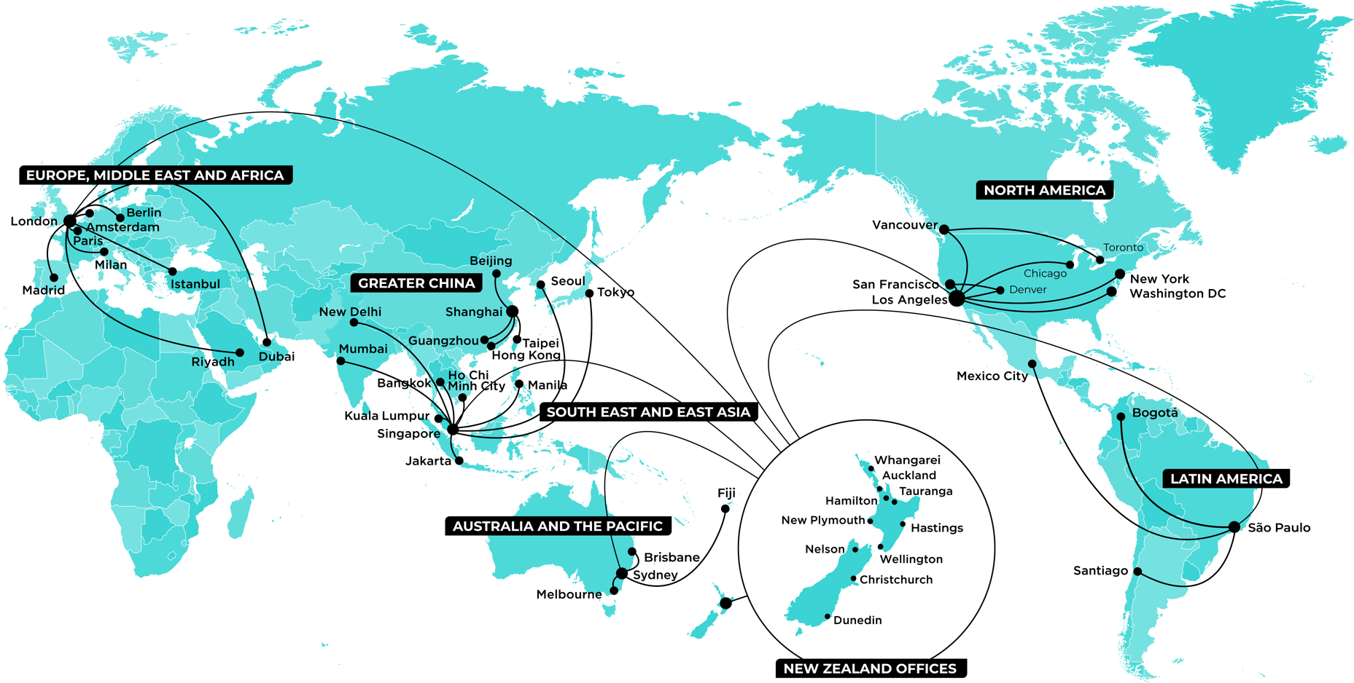
Where we operate
Notes:
Speaker notes
NZTE operates in New Zealand and in six international regions:
Australia and the Pacific (AUSPAC);
South East and East Asia (SEEA), including India;
Greater China;
Europe (including the UK), the Middle East and Africa, (EMEA);
North America and Canada (NAM);
Latin America, (LATAM).
There are 47 different locations, including 10 in New Zealand.
We have over 620 people with around 270 of them based offshore.

Slide 9
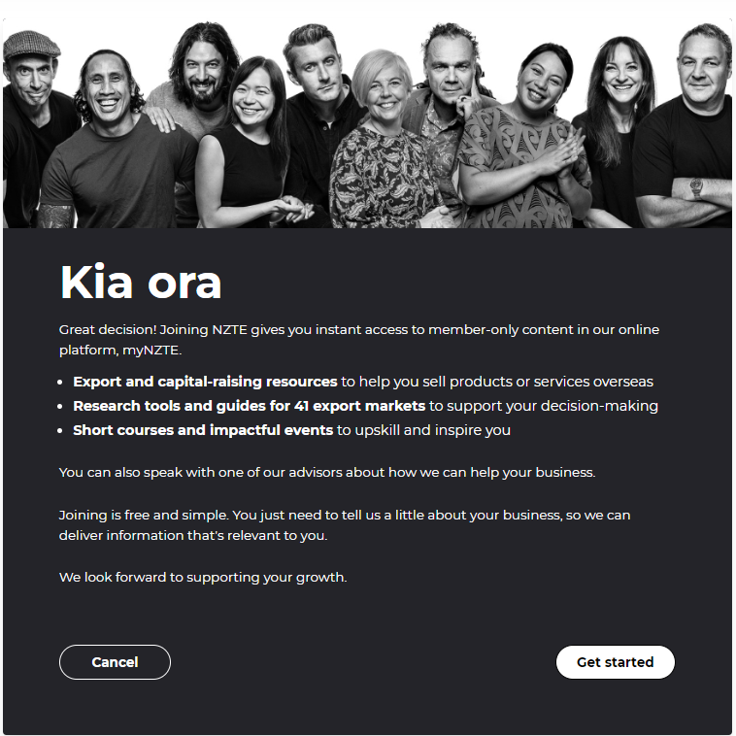
What we offer our customers
myNZTE
Online platform packed with curated, in-depth information and guidance.
Home – myNZTE
Notes:
NZTE offers a range of resources to support business.
If you haven’t worked with us before, we encourage you to register for myNZTE (visit my.nzte.govt.nz/onboarding or just search ‘Join NZTE’ in Google) and you can book a call with our Customer Advisory team.
Anyone can access myNZTE. For full access, all you need to do is log in.
Digital support for Export customers provides three main ways to engage.
myNZTE is NZTE’s free online portal. It offers curated, in-depth information and guidance to help New Zealand exporters navigate their export and capital raising journeys. It includes:
Content: Articles, videos and reports; look at general, market specific or sector specific content. 90% of articles are available without logging into myNZTE.
Events: Discover and register for public or customer only events from NZTE and partners.
Facilitated and self-directed learning: Cohort-led export courses for customers, self-directed for all. Self directed course for Raising Capital.

Slide 10
What we offer our customers
Market Selection & Validation
Market Guides on myNZTE
  Japan Market Guide - Collection – myNZTE
Market Research
  Selling wine in South Korea - myNZTE
  Selling wine in Japan - myNZTE
  Selling wine in Singapore - myNZTE
  Marketing wine to Taiwan consumers - myNZTE
  Is the United States the right market for your wine? - myNZTE
  The Netherlands’ wine market - myNZTE
  Understanding German wine consumers - myNZTE
Notes:
Market Selection & validation
The most successful exporters focus on entering just one market at a time. A structured market selection process reveals which market offers the best opportunities for your business to grow. It lessens the risk of making one of two rookie mistakes:
Entering a market that is too small or too difficult to penetrate.
Spreading yourself too thin across multiple markets, diluting the time and resources you can dedicate to each.
Partner selection
Even if you already have an export market in mind, it's important to test your assumptions through research and market comparison.
Online tools
Talk to people
Seminars/events
Market Entry
Channels to market
Supply chain
Pricing strategies
Sales and marketing
Resource planning

Slide 11
What we offer our customers
Courses & Events
Export Essentials workshops
Introduction to raising capital - InvestEd – myNZTE
Events - myNZTE

Slide 12
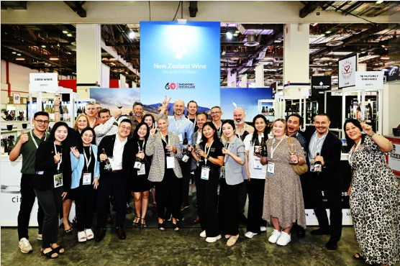
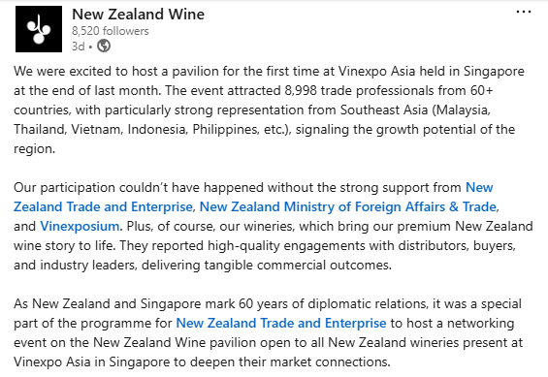
What we offer our customers
Courses & Events

Slide 13
What we offer our customers
Sales & Marketing
Marketing & Brand
  How to build a brand that works overseas – myNZTE
Sales & Digital
NZ Story

Slide 14
What we offer our customers
Specialist expertise & advice
Talking Tariffs: Resources to support NZ exporters with US tariffs - myNZTE
Supply Chain
Sustainability
Kea New Zealand

Slide 15
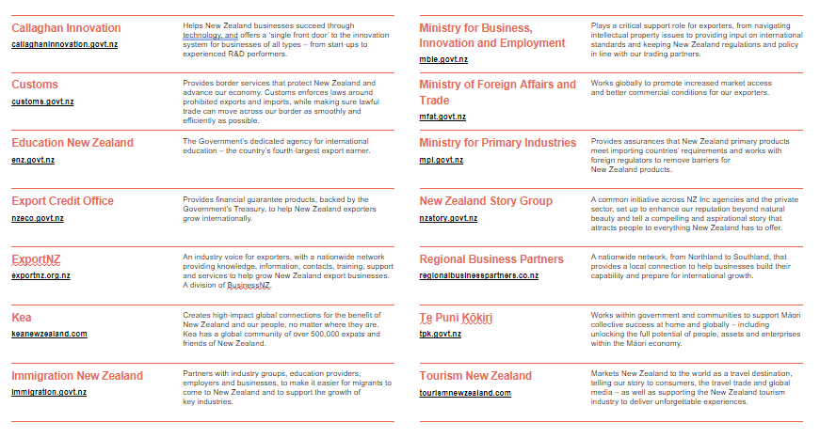
NZ Inc is key to our approach

Slide 16
Thank you

